Slide 1
Hands on Configuring Azure Sentinel

Slide 2



About Me
IT Service desk
System Engineer
Security Engineer
Dad of 1 and expecting our 2nd
Mountain biking
MVP
GCFE
and a lot of legacy or expired certificates

Slide 3

Azure Sentinel
Your Favorite cloud native SIEM+SOAR

Slide 4
What is Azure Sentinel
Cloud Native SIEM and SOAR solution
No more dragging iron to the datacenter
Backend integration with Office 365 and the Microsoft Security stack
Layered on Log Analytics

Slide 5
How do we start
Build:
Resource group
Log analytics workspace
Azure Sentinel solution
Tips:
Location of the Workspace
Retention 90 days
Resource lock

Slide 6
What do we need
Roles:
Global Administrator or Security Administrator
Azure Permissions
Owner or Contributor
Azure Sentinel
Azure Sentinel Contributor
Azure Sentinel Reader
Azure Sentinel Responder
Azure Sentinel Automation Contributor
Logic Apps
Logic App Contributor
Logic App Operator

Slide 7
Let’s get started

Slide 8
Connecting data
Data connectors
Backend to Service
API integration
Microsoft Monitoring Agent
Syslog
CEF
Custom data
Microsoft Monitoring Agent (Files)
Logstash
Logic Apps
PowerShell
Log Analytics API
Azure Functions

Slide 9
Requirements and Costs
Data Connector | License | Permissions* | Cost
Azure Activity | None | Subscription Reader | Free
Azure Defender | ASC Standard | Security Reader | Free
Azure Active Directory | Any AAD License | Global Admin or Security Admin | Billed
Azure Active Directory Identity Protection | AAD Premium 2 | Global Admin or Security Admin | Free
Office 365 | None | Global Admin or Security Admin | Free
Microsoft Cloud App | MCAS | Global Admin or Security Admin | Free**
Microsoft Defender for Identity | MDI | Global Admin or Security Admin | Free
Microsoft Defender for Endpoint | MDI | Global Admin or Security Admin | Free**
Threat Intelligence Platforms | None | Global Admin or Security Admin | Billed
Security Events | None | None | Billed
Syslog | None | None | Billed
DNS (Preview) | None | None | Billed
Windows Firewall | None | None | Billed

Slide 10
Connect sources

Slide 11
Automation
Component | Automated with
Onboarding | API, PowerShell, ARM
Alert Rules | API, PowerShell
Hunting Queries | API, PowerShell
Playbooks | ARM
Workbooks | ARM
Connectors | API
PowerShell (AZ Sentinel)
Query API Directly
ARM Templates

Slide 12
Fast Forward
Notes:
https://github.com/SecureHats/Sentinel-playground

Slide 13
Threat Intelligence
How
Security Graph
Built-in TAXII
Platforms
Anomali ThreatStream
MISP
Palo Alto Minemeld
Eclectic IQ
Recorded Future
Notes:
https://docs.microsoft.com/en-us/azure/sentinel/import-threat-intelligence

Slide 14
Threat Intelligence
Notes:
API Root (https://limo.anomali.com/api/v1/taxii2/feeds/)Collection ID
Phish Tank107Abuse.ch Ransomware IPs135Abuse.ch Ransomware Domains136DShield Scanning IPs150Malware Domain List - Hotlist200Blutmagie TOR Nodes209Emerging Threats C&C Server31Lehigh Malwaredomains33CyberCrime41Emerging Threats - Compromised68

Slide 15
Turning data into alerts
Analytics rules
Built-in in Azure Sentinel
Kusto Query Language
GitHub and Blogs

Slide 16
Kusto Time
Notes:
https://github.com/Azure/Azure-Sentinel/tree/master/Detections/SigninLogs

Slide 17
Automating Responses
Playbooks
Logic Apps
GitHub

Slide 18
SOAR-ing
Notes:
https://github.com/Azure/Azure-Sentinel/tree/master/Playbooks/Block-AADUser

Slide 19
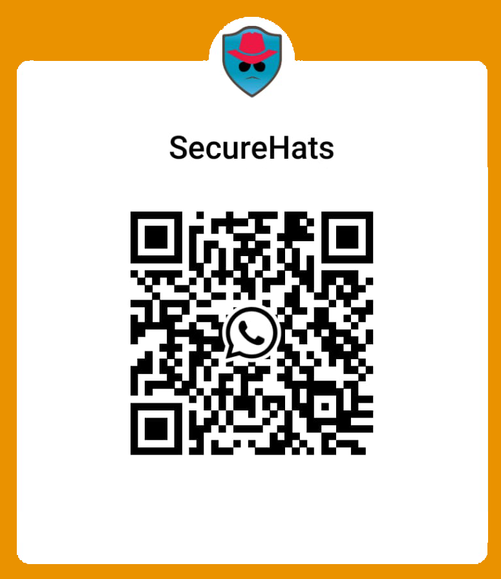
Recommendations:
https://github.com/OTRF by @Cyb3rWard0g and @Cyb3rPandaH
Deploying and Managing Azure Sentinel by @PKhabazi
SecureHats (SecureHats) (github.com) by @DijkmanRogier
Grand Connector List by @Oshezaf
Sentinel Ninja Training by @Oshezaf
https://m365internals.com/ by @DebugPrivilege
https://www.getrevue.co/profile/AzureSentinelToday by @RodTrent
https://www.youtube.com/c/MaartenGoet/ by @Maarten_Goet
Azure Sentinel Github by Microsoft, the community and you
Azure Sentinel - Microsoft Tech Community by Microsoft, the community and you

Slide 20
Questions Page

Slide 21

THANK YOU!
/KustoKing
/Kusto King
@castello_johnny
/ giannicastaldi

